Slide 1
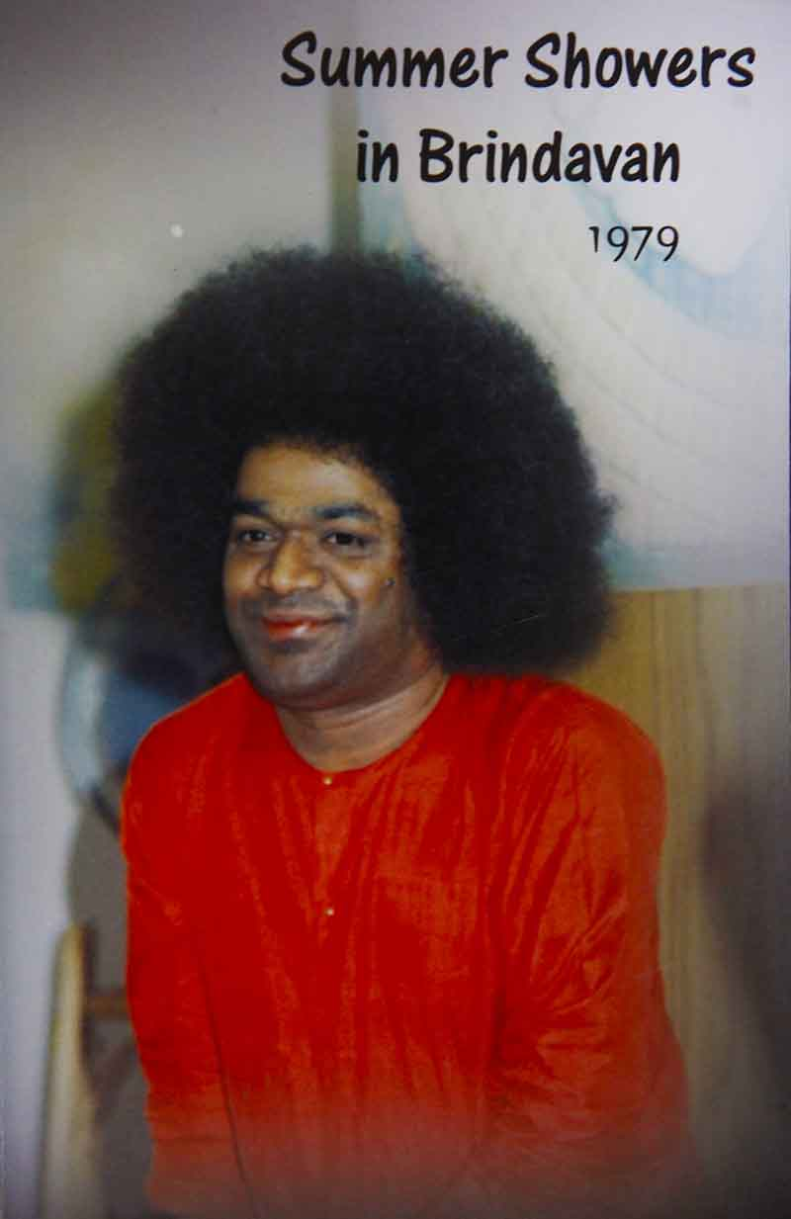
JNANA YAGNA
Chapter 11 in SSB 1979

Slide 2
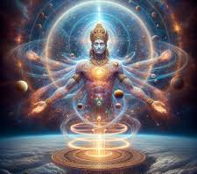
Way to Adwaitha
Love is the Form of Brahman; Brahman is Love Divine.
The merger of human love with Divine Love brings about Cosmic Order.
One who is full of love attains Adwaitha.

Slide 3
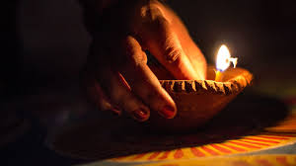
Jnana can dispel ignorance
An individual seeking to realise Divinity must possess the primary prerequisite of chittasuddhi or purity of heart. Even as poisonous creatures like snakes and scorpions do not enter a clean and well-lit room, desire, anger, envy and hatred do not enter a mind which possesses purity and wisdom.
The removal of ignorance is not an impossible task as would be the case in an attempt to wash a piece of charcoal pure white with milk. One who seeks to dispel the darkness of ignorance must necessarily acquire jnana (spiritual wisdom). Just as a lamp is needed to drive away darkness, jnana or wisdom is the only antidote for ignorance. Nascence is like the encrustation on a copper vessel which can be washed off; it is like the husk covering the grain of rice that can be removed by the process of threshing.

Slide 4
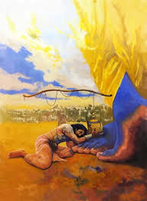
Sacred Yoga of Spiritual Wisdom- Jnana Yagna
Arjuna, who was ridden by doubt and hesitation, was unable to recognise his own real nature. Neither was he, stricken by despondency, able to act in accordance with the commands of Krishna. Krishna, therefore, infusing courage and confidence in him, instructed him on the sacred yoga of spiritual wisdom— jnana yoga. Krishna said, “Arjuna, all actions must ultimately find their fulfilment in jnana and must, therefore, be performed with meticulous care.”

Slide 5

How to perform Jnana Yagna?
Jnana can be considered in many ways. It is considered as a yajna and even thapas, or austerity, through which people endeavour to attain the Divine. Jnana yajna can be performed by all irrespective of caste, creed, religion or sect. Whosoever performs actions as offerings to God, for His pleasure and without any desire whatsoever for the fruits thereof, performs jnana yajna. Krishna says, “Those who cognise Brahma in all actions, verily perform jnana yajna.”

Slide 6
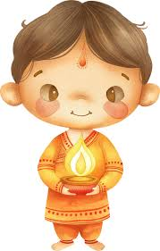
The flame of Jnana
Krishna kindled in Arjuna the flame of jnana. To light a lamp, a container, oil, wick and fire are necessary. But, most essentially, there should be someone to light it. Similarly, for lighting the fire of jnana in an individual, he should possess in him the container of vairagya (detachment), the oil of bhakthi (devotion), the wick of indriya nigraha (sense control) and the fire of Atma vichara (self-enquiry). “In you are present these essential qualities and so I shall kindle the flame of jnana in you,” said Krishna to Arjuna.

Slide 7
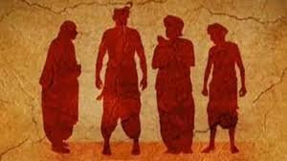
Why caste?
Explaining the reason why caste distinctions have been made, Krishna said, “I have created the four varnas to promote swadharma, samajika dharma, vishwa dharma, and Easwara dharma and to establish them permanently in this world so that, in turn, the flame of jnana will burn bright forever.” The four varnas are the brahmins, the kshatriyas, the vaisyas, and the sudras.

Slide 8
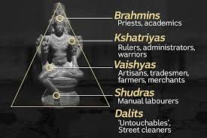
The Purusha and castes
Passages in the Purusha Sukta describe the different varnas as parts of the Lord’s body. The brahmins, who regard the Vedas and Sastras as perennial and abiding truths and as the pathways along which humanity must progress, are described as the face of Brahma. The kshatriyas, kings, who sacrifice their bodies for the sake of the country and utilise their physical prowess for the defence of the country’s cultural and territorial integrity, are described as the shoulders. The wealthy vaisyas, who engage themselves in charity, distributing their wealth to all and sundry, have been described as the thighs. The feet are the sudras, who engage themselves in cultivation and maintaining the regular supply of grain for food.

Slide 9

Thorn example
Each organ of the body works in unison with the rest of the body while discharging faithfully its own assigned function. Should something happen to any limb, the danger is shared by the other organs who come forward to mitigate the pain of the affected part. A small example illustrates this. While a person is walking along a path, a thorn is noticed by the eyes. On account of the internal communication system between the eye, which is on the face, and the foot, which is at the bottom, the thorn is avoided by the foot. If the thorn pricks the sole of the foot, the eye shares the pain and sheds tears sympathetically.

Slide 10
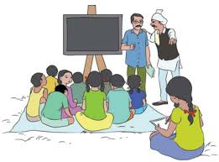
The current scenario of caste
In the same manner, the different castes should work in co-ordination with each other and share the joys and sorrows of each other. This spirit of mutual love and unity is essential for the promotion and protection of dharma in society. In a body, the same heart animates the head, the shoulders, the thighs and the feet and the same blood flows through all of them. Thus, there is no room for distinctions and differences among the four. Likewise the brahmins, the kshatriyas, the vaisyas, and the sudras must remember that they are all motivated by the same Divine life-force and must not allow caste difference and discrimination to arise. However, through the centuries, the inner significance has been forgotten and the caste system has been made a basis for sectarian distinctions and communal disharmony.

Slide 11
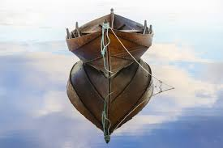
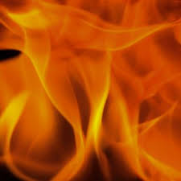
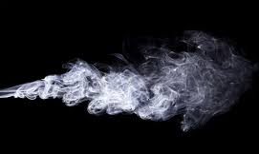
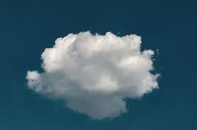
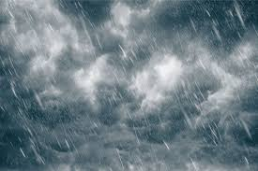
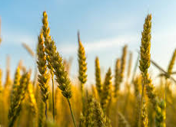
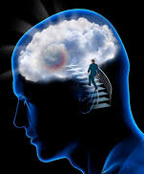
Wisdom as boat and fire
Wisdom has been likened to a boat which can take man across the turbulent waters of samsara or worldly existence. It has also been described as the fire which burns all illusions, impurities and idiosyncrasies of human nature. In this connection, let us examine the connection between the fire and our food. The smoke depends on the fire, the cloud depends on the smoke, the rain depends on the cloud, the crop depends on the rain, and the food depends on the crop we harvest. Further, the attitude and qualities of our mind are conditioned by the food we consume.

Slide 12
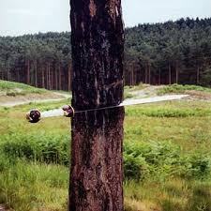
Wisdom as a sword
Let us consider wisdom as a sword, too. Desire, anger, passion, greed, pride, and envy take roots and grow like mighty trees in our hearts, destroying our innate humanity. Wisdom is the sword with which we must cut off these trees and live a quiet and happy life.

Slide 13
Back to the essence of Nishkama Karma
Thus, in the fourth chapter of the Gita, Krishna explained the genesis of the four varnas and described jnana yoga. He emphasised that no other yajna need be performed if jnana yajna is undertaken. He exhorted Arjuna to dedicate his actions to the Lord and realise through them, the unity of mankind. Yajna is the dedication of all the powers man is endowed with, to the supreme Lord. It can be performed by all—men, women, children, aged people, the rich and the poor. Whoever performs actions in a spirit of dedication to the Lord, performs jnana yajna.
योगसन्न्यस्तकर्माणं ज्ञानसञ्छिन्नसंशयम् ।
आत्मवन्तं न कर्माणि निबध्न‍‍न्ति धनञ्जय ॥ ४१ ॥
yoga-sannyasta-karmāṇaṁ
jñāna-sañchinna-saṁśayam
ātmavantaṁ na karmāṇi
nibadhnanti dhanañ-jaya

Slide 14
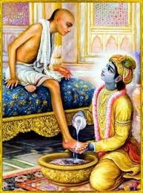
Live with self-realisation
To perform this, money and materials are not necessary. Virtue is the prime requisite, the heart is the altar, thoughts are the offerings, and delight is the ultimate fruit. One must undertake actions in this spirit for the attainment of Supreme Delight, the delight of Life, the delight of the Spirit and the delight that is Divine. Jnana yajna is the performance of action, discarding the spirit of attachment and ego. Trying to live with self-realisation is the essence of jnana yajna.

Slide 15
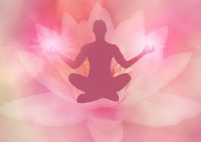
Source of relationships
“Who are you? Whence have you come? Whither do you go?” We are in a pitiable plight, harping on “mine” and “thine” and not knowing the answers to these questions. Where were you before your birth? Where would you be after death? Who are your children? Who are your friends? Man has none to call his own. All these relationships arise from selfish attachments and do not indicate any permanent bond.

Slide 16
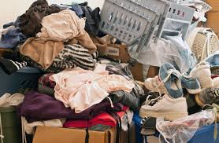
Bodies are vestments
“Recognise this truth”, Krishna told Arjuna. “Do not entertain the attitude of weakness and illusion, proceeding from ignorance. Do not become feeble-hearted by calling these people your uncles, gurus, friends and sires.” Emphasising further, Krishna said, “O Arjuna! You are not the killer and they are not killed. These bodies resemble mere vestments. None feels sorry to throw away old and soiled garments. All these bodies are like worn-out dispensable garments.”

Slide 17
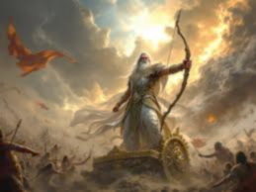
Arjuna’s doubt
Arjuna had a doubt.
“It may be proper to compare the bodies of people who are eighty, ninety or a hundred years old to disposable garments; how is it proper to compare the bodies of those who are five or ten years old to clothes which have served their purpose?

Slide 18

Krishna’s illustration
Krishna answered Arjuna, “You do not have the authority to decide which is old and which is new. Such discrimination has not yet developed in you.” I am giving one small illustration. Ten years ago you purchased a piece of cloth, kept it somewhere and forgot about it. When you happen to open the almirah now, that cloth attracts your attention. At once you take it to a tailor and have a coat made out of it. When you put on this new coat, you feel happy that you are donning it. But when you bend forward the coat gets torn. You feel sorry that your new coat is torn. Though the coat is new, the cloth is of old stock. Likewise, the bodies of a young person may appear as new and fresh, but may be of old stock belonging to some previous births. Just as the garment is the cloak for the body, the body is the vesture of the spirit. Krishna thus compared the body to a garment which gets soiled and worn-out, drops off and is reduced to ashes.

Slide 19

Death is the dress of life
“Death is the dress of life.” At the time of death, we cast off one dress and don another. No one laments when he is told that fire is hot or ice is cold. It is quite a natural phenomenon. Similarly, it is natural for the body that is born, to die. To lament over it, is sheer ignorance. The knowledge of the Self is essential to exterminate this ignorance. It is the duty of every individual to acquire this self-knowledge, to recognise the true destination of life and to strive to merge in the sacredness of Divinity.

Slide 20
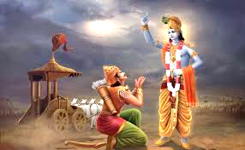
Carry on the fight against evil
“O, Arjuna! Do not feel that you are fighting your relations and friends. Consider that you are fighting your own vile tendencies. These enter your nature like friends and then torment you like foes. Therefore, with the support of good qualities, you should fight against your evil qualities. Continuing to think of Me always, carry on the fight,” Krishna advised.

